Slide 1

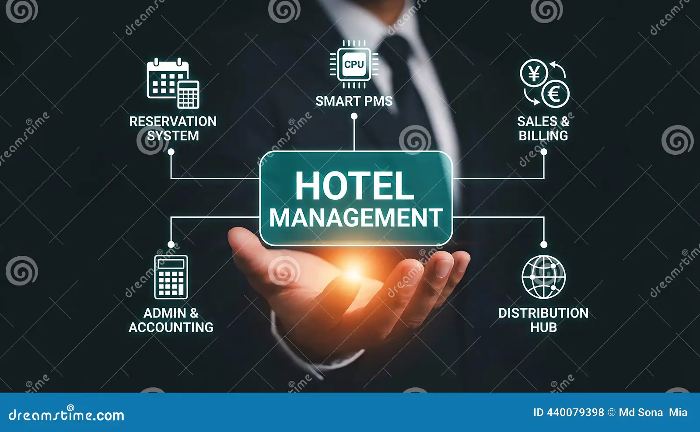

Hotel Management System
Case Study Presentation
Using SQL
By
Kajal Hemant More.

Slide 2
Introduction
The main objective of this project is to design a structured relational database that stores and processes data related to guests, rooms, bookings, services, and payments. In this system, SQL is used to create tables, define relationships using primary and foreign keys, and perform operations such as inserting, updating, deleting, and retrieving data. The database ensures data consistency, reduces redundancy, and provides fast access to information. This project use of including normalization, joins, aggregation functions, group by, having, order by and subqueries.

Slide 3
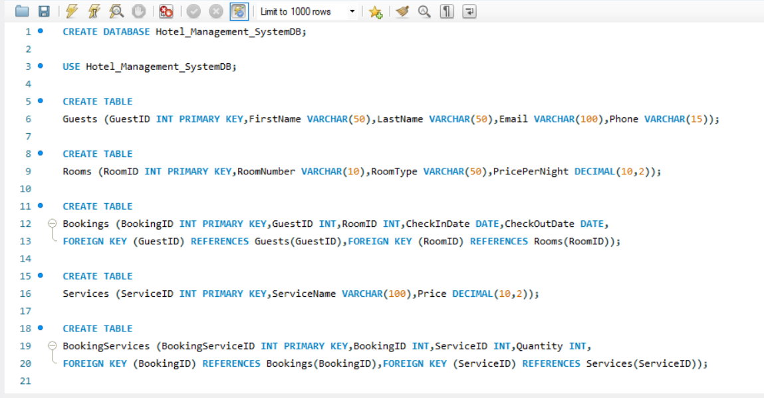
Create Tables:
Write SQL statements to create all the tables with the specified columns.

Slide 4
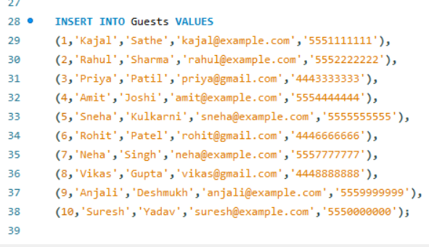
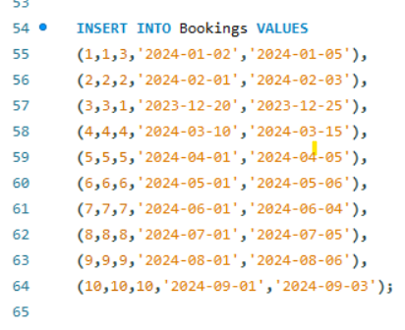
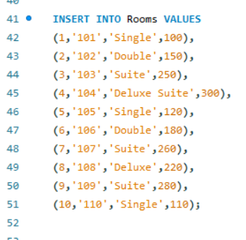
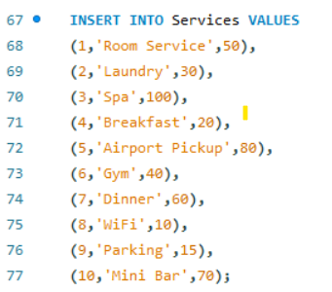
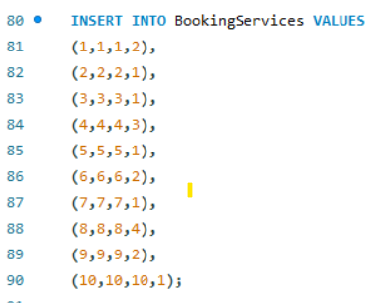
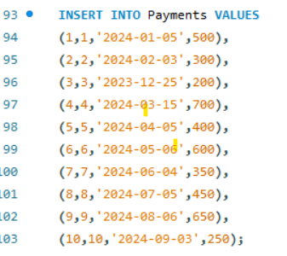
Insert Records:
Insert at least 10 records in all the tables.

Slide 5
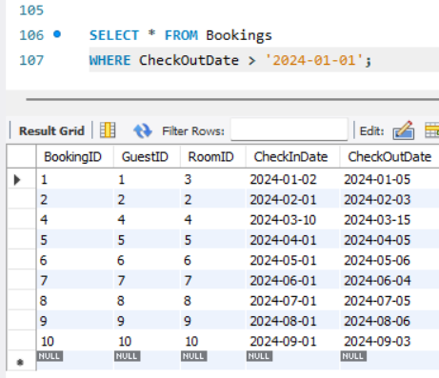
Select Records:
Write a query to select all bookings from the Bookings table where the Check Out Date is after January 1, 2024.

Slide 6
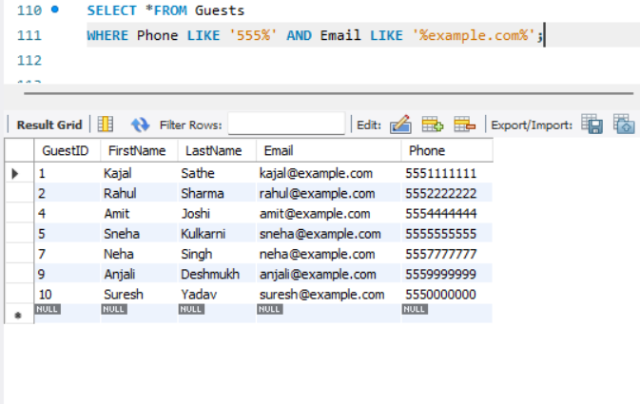
Where Clause (AND/OR):
Write a query to select all guests who have a phone number starting with '555' and an email containing 'example.com'.

Slide 7
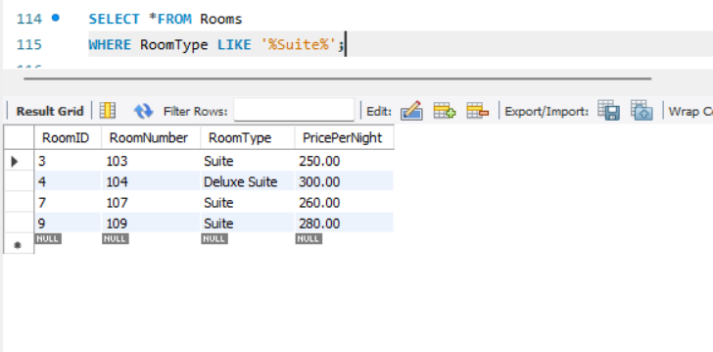
LIKE Operator:
Write a query to select all rooms where the Room Type contains 'Suite'.

Slide 8
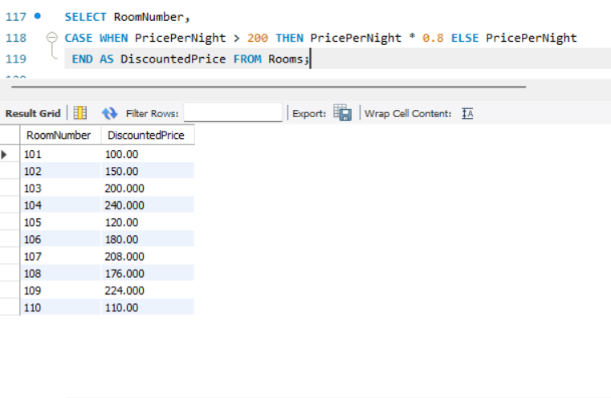
CASE Statement:
Write a query to select Room Number and a new column Discounted Price from the Rooms table. If Price Per Night is greater than $200, set Discounted Price to Price Per Night * 0.8, otherwise Price Per Night.

Slide 9
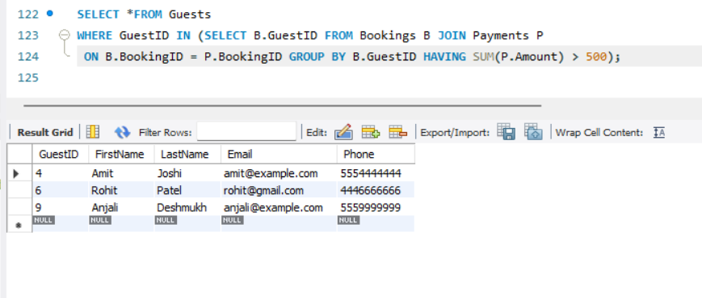
Subquery:
Write a query to find all guests who have made bookings with a total amount exceeding $500. Use a subquery to find these Guest IDs.

Slide 10
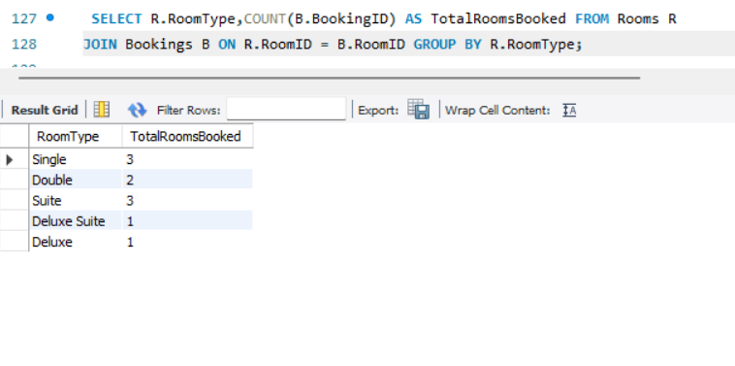
Group By:
Write a query to get the total number of rooms booked by each Room Type. Group the results by Room Type.

Slide 11
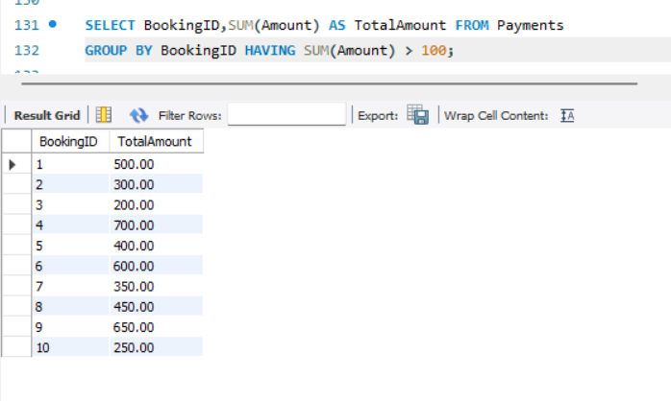
Having Clause:
Write a query to get the total amount paid for each booking, but only include bookings where the total amount is greater than $100. Use the HAVING clause.

Slide 12
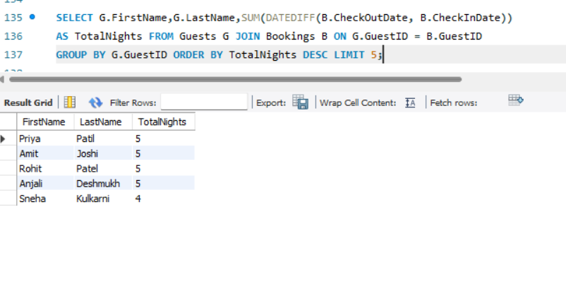
Limit:
Write a query to select the top 5 guests who have stayed the most number of nights.

Slide 13
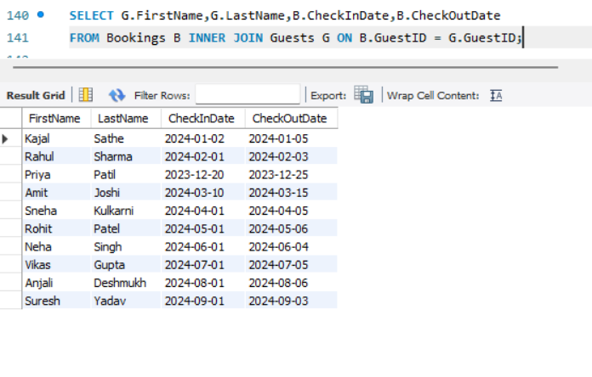
Inner Join:
Write a query to join Bookings with Guests to get a list of all bookings with FirstName, LastName, Check In Date, and Check Out Date.

Slide 14
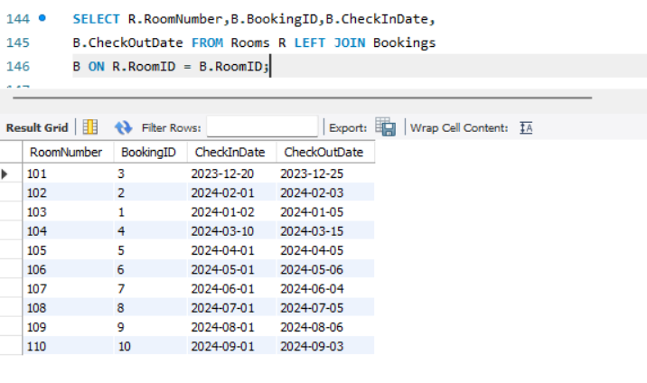
Outer Join:
Write a query to get a list of all rooms and any associated bookings. Include rooms that might not be booked.

Slide 15
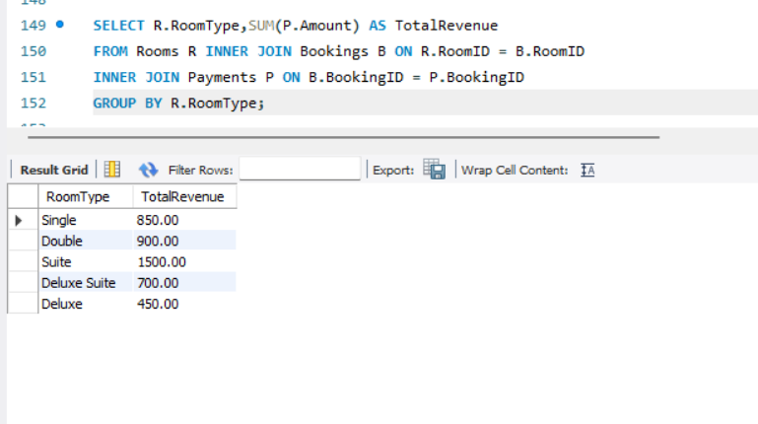
Join with Aggregation:
Write a query to get the total revenue generated by each Room Type. Use an INNER JOIN between Rooms and Bookings, and group by Room Type.

Slide 16
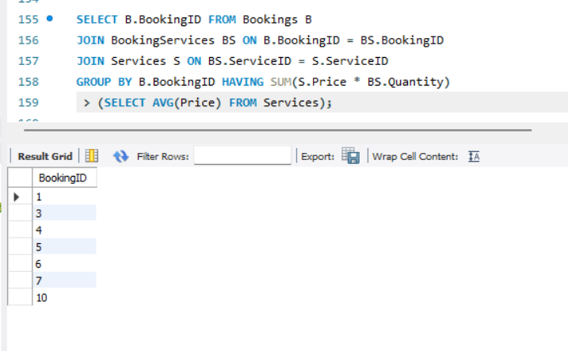
Subquery with Join:
Write a query to find all bookings where the total services cost is higher than the average service cost. Use a subquery in the WHERE clause.

Slide 17
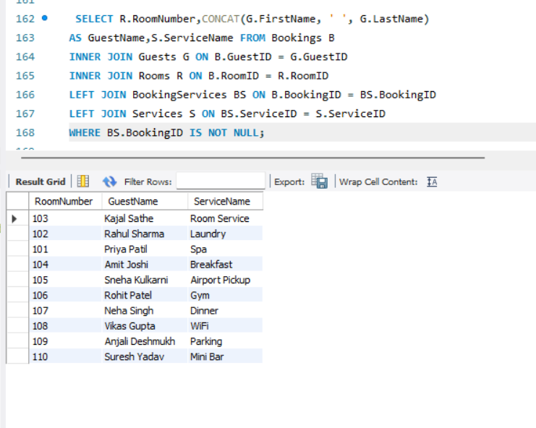
Advanced Join:
Write a query to list Room Number, Guest Name, and Service Name for all rooms that have been booked and where additional services were provided. Use INNER JOIN and LEFT JOIN as necessary to get all required details.

Slide 18

THANK YOU

